Slide 1
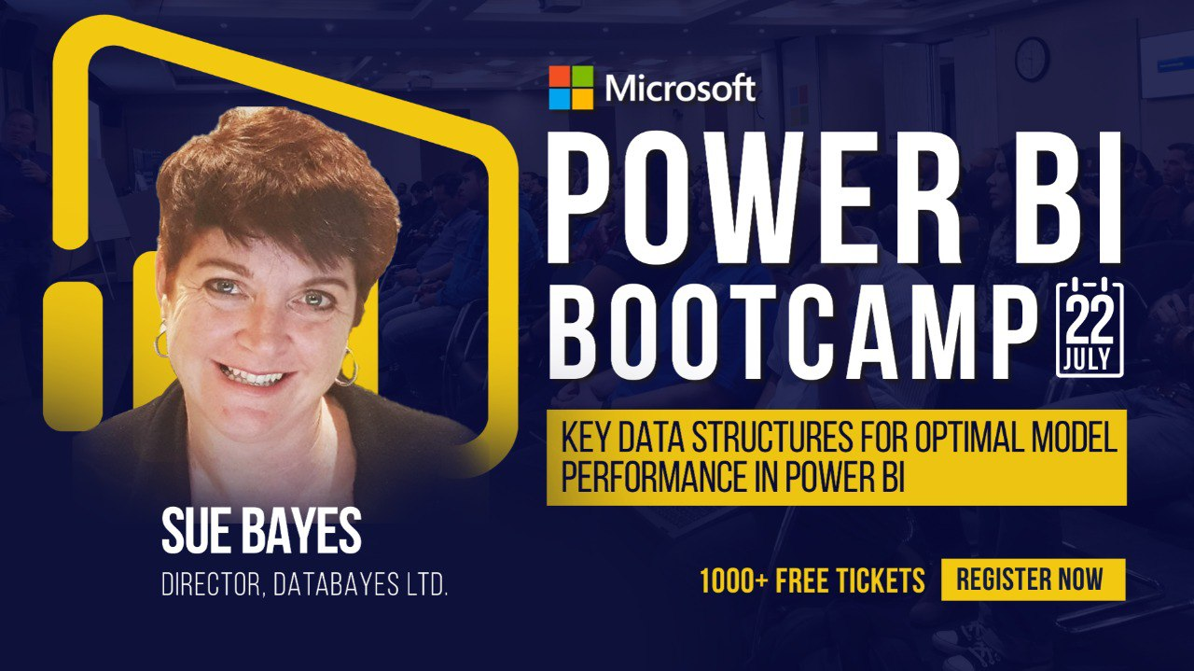

Slide 2
Key Concepts and Structures for optimal model performance in Power BI
Sue Bayes

Slide 3

Sue Bayes
Microsoft Certified: Data Analyst Associate | MCSA BI Reporting | BI & Excel Developer
I develop reports and models using Microsoft Power BI, Microsoft Excel, R and Python. I can programme in M, DAX, Python, R, SQL and VBA (to a degree!) and am a certified Microsoft Office Specialist in Excel, Access, PowerPoint, Word and Excel
Linked In : https://www.linkedin.com/in/suebayes/
Twitter: https://twitter.com/sue_bayes
Notes:
I’d like to know if so that gives me an idea of the audience:
Do you use Excel
Do you use Python
Do you use R
Do you use Microsoft PowerBI
Do you use Tableau
Do you use Power Query

Slide 4
Learning Outcomes
You will be able to:
Recognise the key basic concepts behind different types of data
Understand the importance of data types
Learn how to effectively model data within Power BI
Understand what is meant by normalised data
The importance of a Star Schema
How the engine works
Notes:
You will be able to:
Recognise the key basic concepts behind different types of data and how they’re used
Explain the life cycle of organisational data and how to manage it
Be aware of the different tools used for managing data and analysing data
Describe common obstacles and hurdles to effectively leverage data
You will be able to:
Recognise the key basic concepts behind different types of data
Understand the importance of data types
Learn how to effectively model data within Power BI
Understand what is meant by normalised data
The importance of a Star Schema
How the engine works

Slide 5
Contents
Definitions
Types of Data
Data Types
Tips and Tricks
Normalised Data
Star Schema
Vertipaq

Slide 6
Business context
Numeric
Categorical
Time Series

Slide 7

Numeric
QUANTITATIVE / FACTS
Numbers that represent measurements or values
Discrete
Continuous
Notes:
Examples – discrete – items that can be counted, eg number of heads tossed when tossing a coin
Continuous – intervals on the real number line, eg, age

Slide 8
Categorical / Dimension
Gender
Marital Status
Hometown
Types of movies
QUALITATIVE

Slide 9
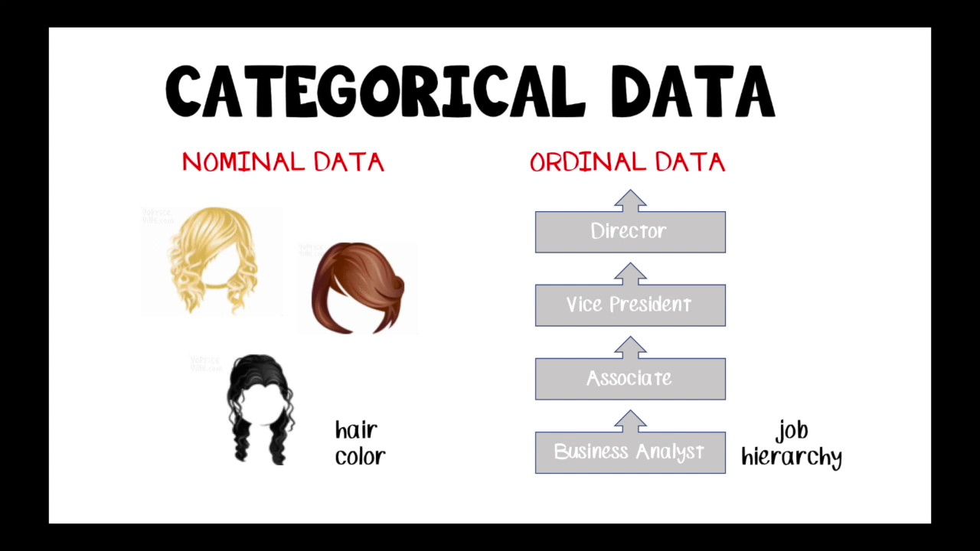
Notes:
https://www.dummies.com/education/math/statistics/types-of-statistical-data-numerical-categorical-and-ordinal/
Ordinal data mixes numerical and categorical data. The data fall into categories, but the numbers placed on the categories have meaning. For example, rating a restaurant on a scale from 0 (lowest) to 4 (highest) stars gives ordinal data.

Slide 10
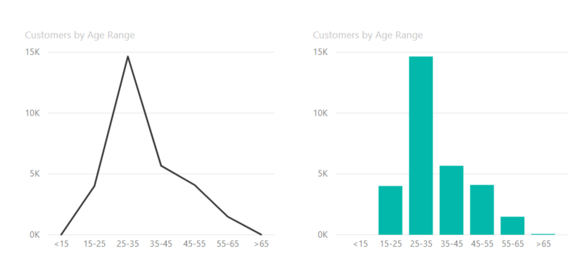
Discrete
Continuous
Notes:
Poll
Which axis is discrete – x or y – Answer y – items that can be counted
Which axis is continuous – x or y – Answer x – within a range

Slide 11
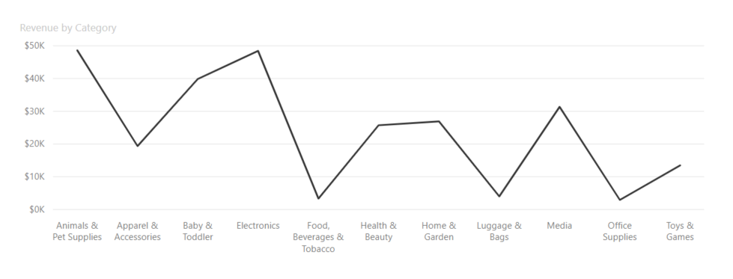
Discrete
Category
Notes:
Poll
Which axis is discrete – x or y – Answer y – can be counted
Which axis contains categorical data – x or y – Answer x – type of product

Slide 12
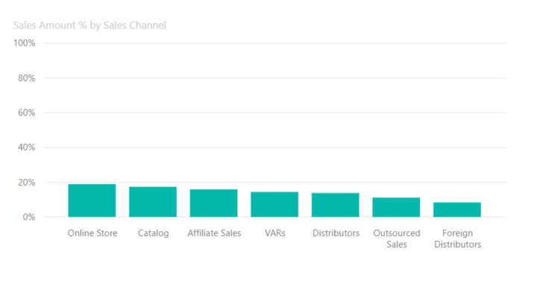
Continuous
Category
Notes:
Poll
Which axis is continuous – x or y – Answer y – within a range
Which axis contains categorical data – x or y – Answer x – Type of channel

Slide 13
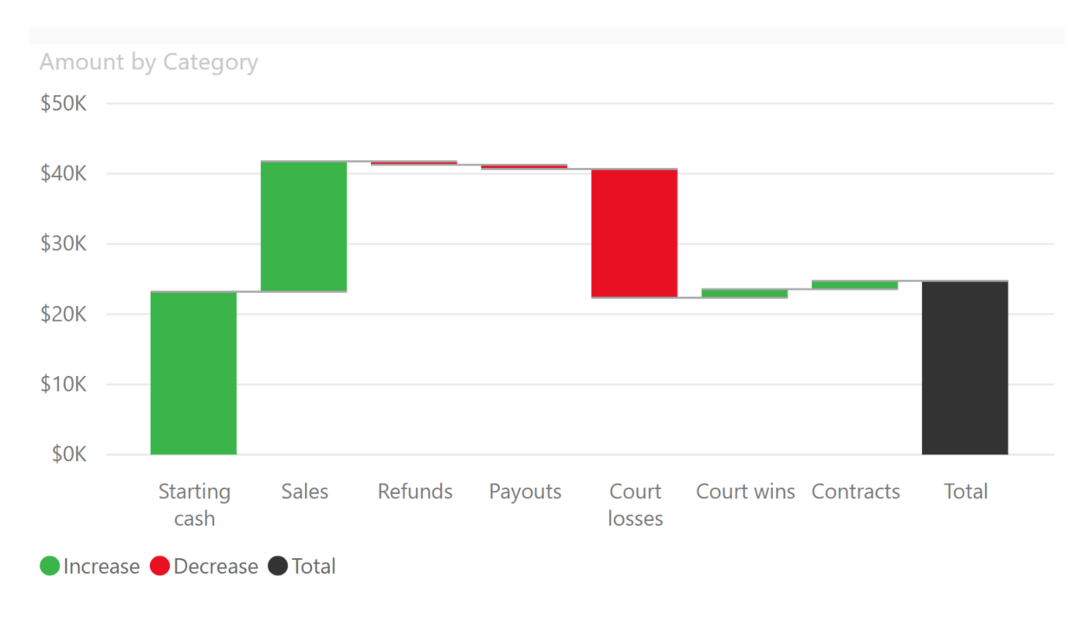
Notes:
Poll
Which axis is discrete – x or y – Answer y – can be counted
Which axis contains categorical data – x or y – Answer x – type of costs

Slide 14
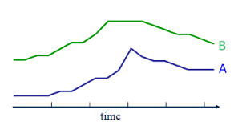
Time Series
Performance
Forecast
Comparison
Notes:
Month on Month
Month to Date
Year on Year

Slide 15
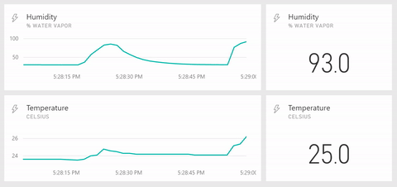
Notes:
Temperature – can be counted
Time series
Value

Slide 16
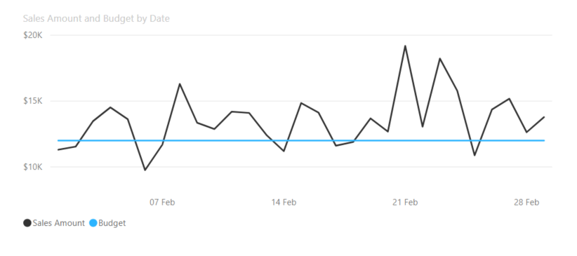
Notes:
https://exceltable.com/en/analyses-reports/time-series-analysis

Slide 17
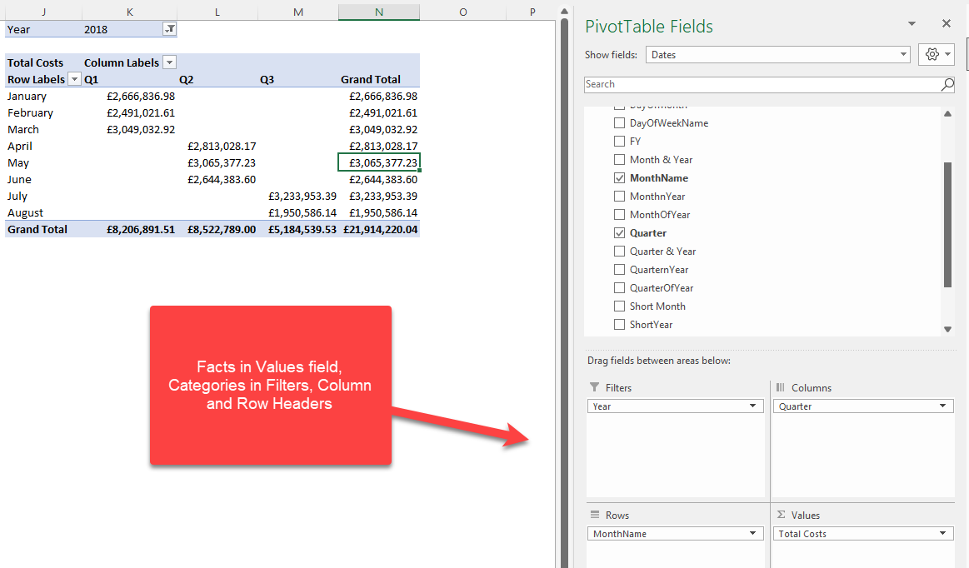

Slide 18
Business context
Numeric
Categorical
Time Series

Slide 19

Structured vs Unstructured
This Photo by Unknown Author is licensed under CC BY-ND
What’s the difference?

Slide 20
 | Structured Data | Unstructured Data
Characteristics | Pre-defined models | No pro-defined data model
 | Easy to search | May be text, images, sound, video or other formats
Typical Applications | Reservation systems | Word processing
 | Inventory control | Presentation Software
 | CRM systems | Email clients
Examples | Dates | Text files
 | Phone numbers | Reports
 | Social security numbers | Email messages
 | Credit card numbers | Audio files
 | Customer names | Video files
 | Addresses | Images
 | Transactional information | Surveillance imagery

Slide 21

Unstructured:
Paper copies
Photos
Bar codes
X Rays
Notes
Social Media feeds
Videos
Audio Transmissions

Slide 22
What % of data is unstructured?

Slide 23


Slide 24
Structured Data – not tidy!
Bills | Jan-18 | Feb-18 | Mar-18 | Total | Percent
Rent | £1,200 | £1,200 | £1,200 | £3,600 | 61%
Car | £250 | £250 | £250 | £750 | 13%
Credit Cards | £125 | £150 | £120 | £395 | 7%
Food | £300 | £250 | £350 | £900 | 15%
Phone | £75 | £75 | £90 | £240 | 4%
Total | £1,950 | £1,925 | £2,010 | £5,885

Slide 25
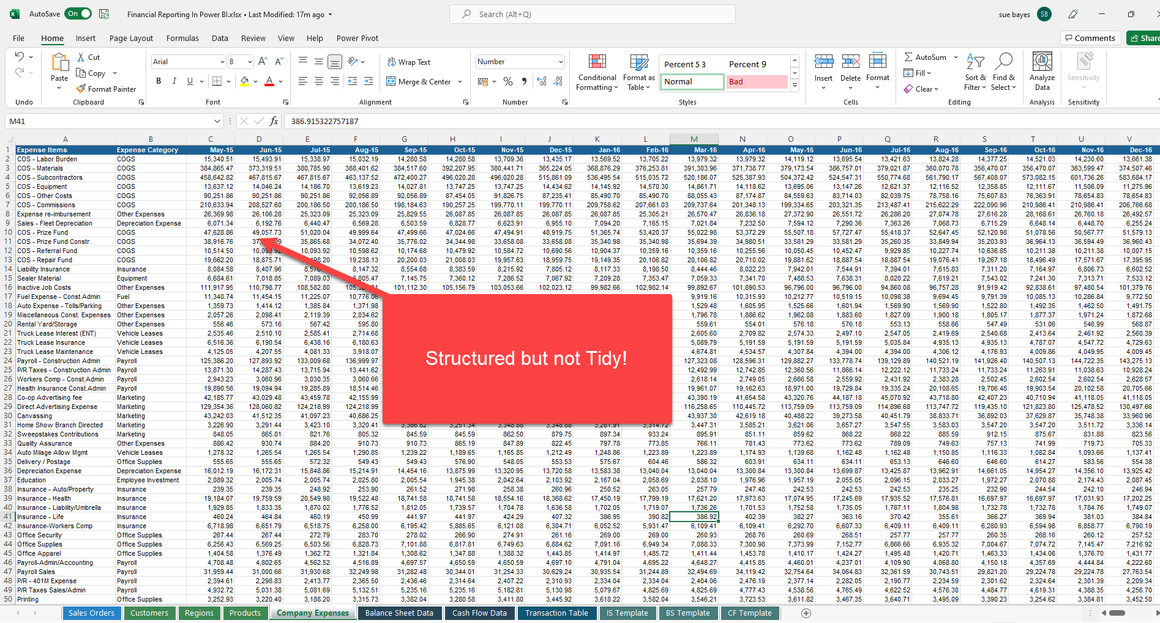

Slide 26
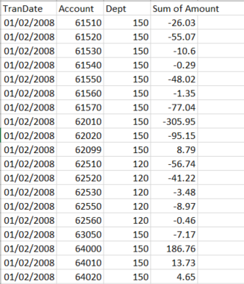
Tidy Column = Variable Row = Observation Cell = Single Value

Slide 27
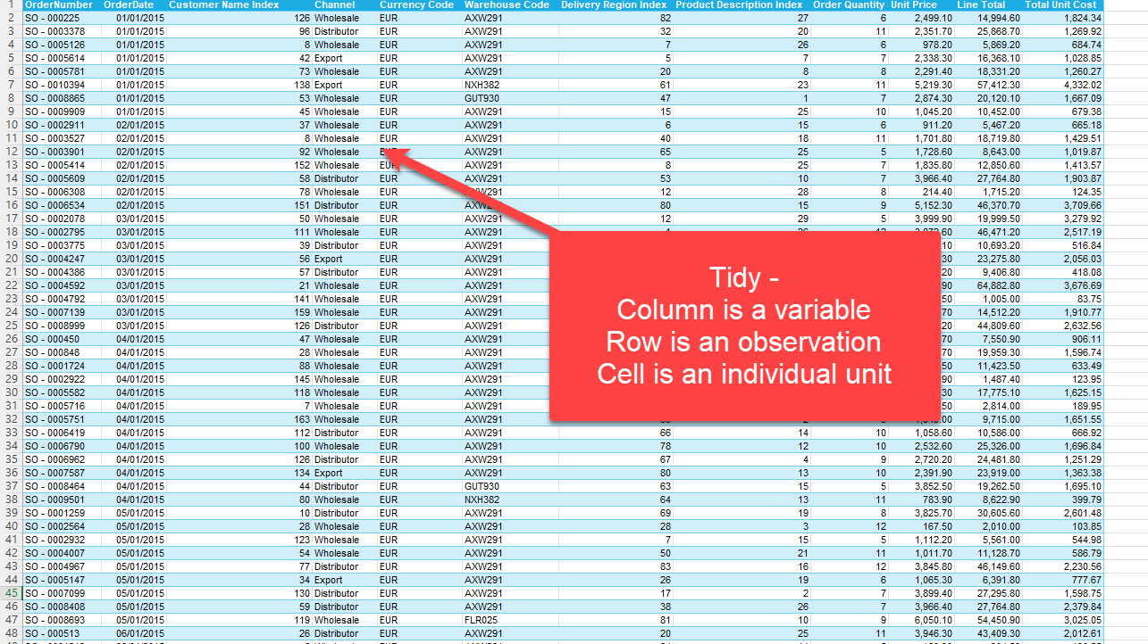
Date is unpivoted
Notes:
https://cran.r-project.org/web/packages/tidyr/vignettes/tidy-data.html

Slide 28
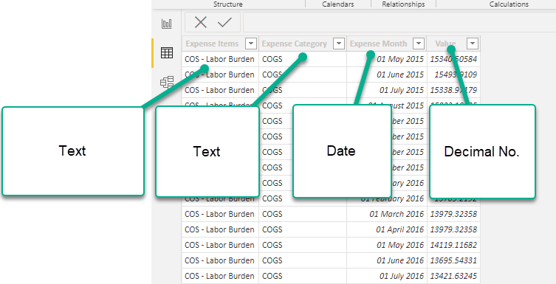

Slide 29

Why does this even matter?
This Photo by Unknown Author is licensed under CC BY-NC

Slide 30
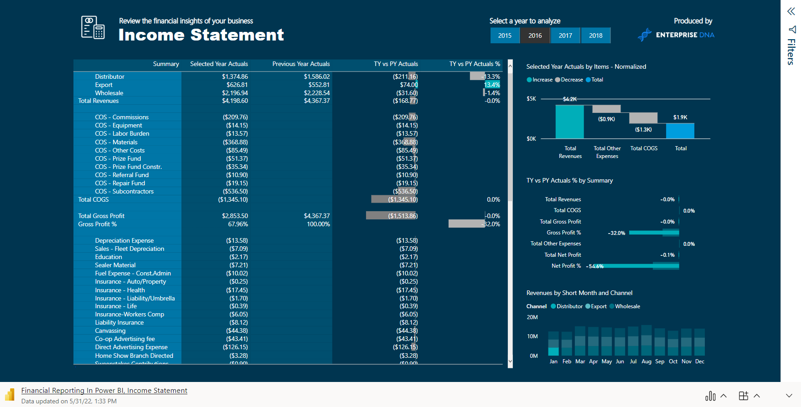
Examples

Slide 31
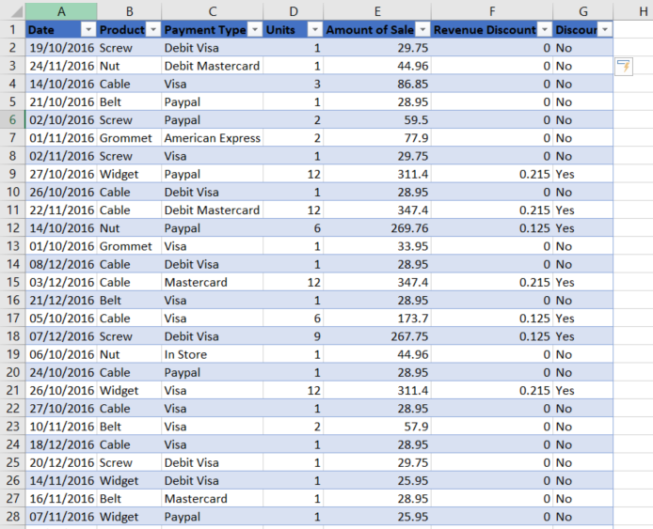
Data Types
String
Integer / Whole Number
Float / Decimal Number
Boolean
Array
Currency
NULL – Blank – N/A – no data
Date
https://docs.microsoft.com/en-us/powerquery-m/power-query-m-function-reference
= #shared
Notes:
https://support.office.com/en-us/article/data-types-in-data-models-e2388f62-6122-4e2b-bcad-053e3da9ba90
= #shared
Which column for String – B or C
Which column for integer – D
Float – E or F
Boolean – G

Slide 32
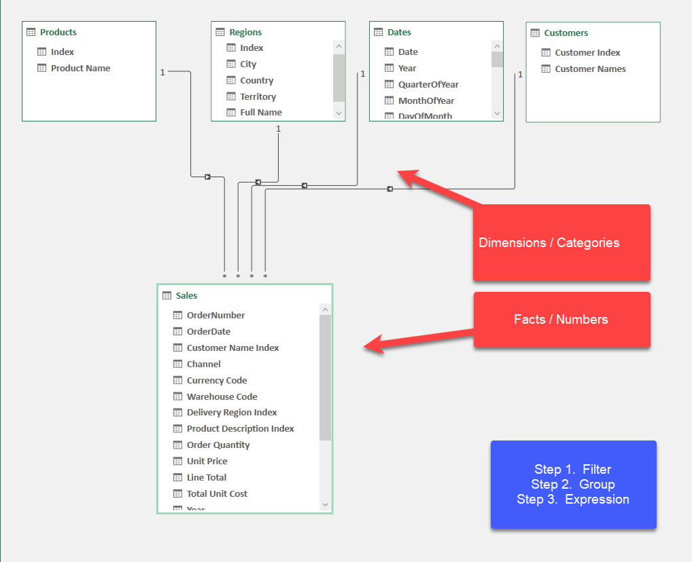
Star Schema

Slide 33
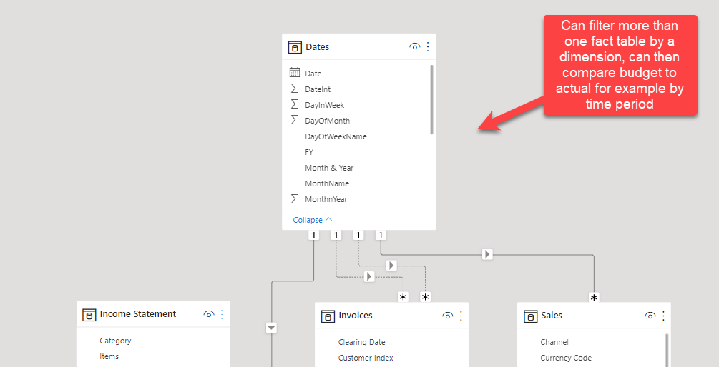

Slide 34
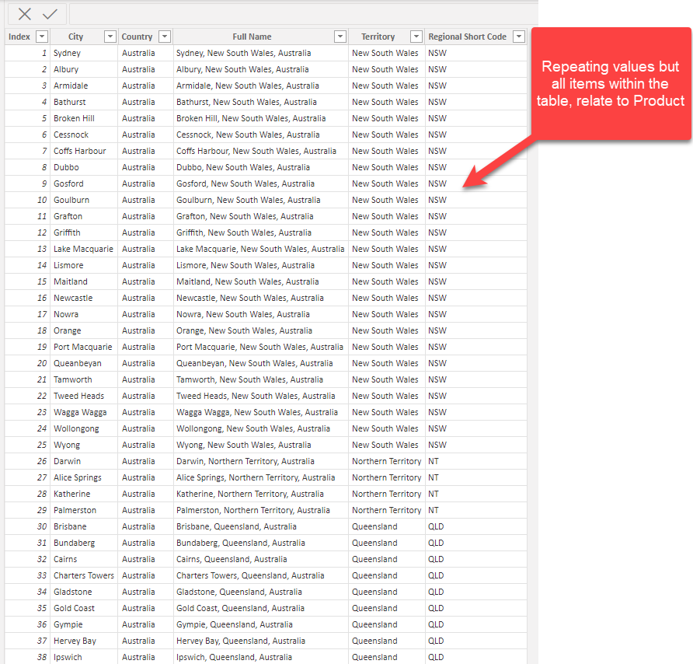
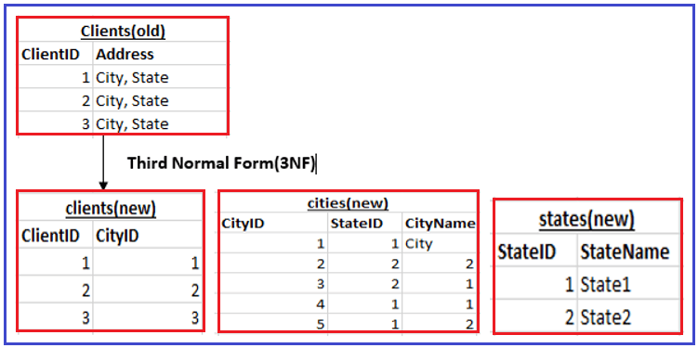
Normalisation – 1NF or 3NF……
3nf database visual representation - Bing

Slide 35
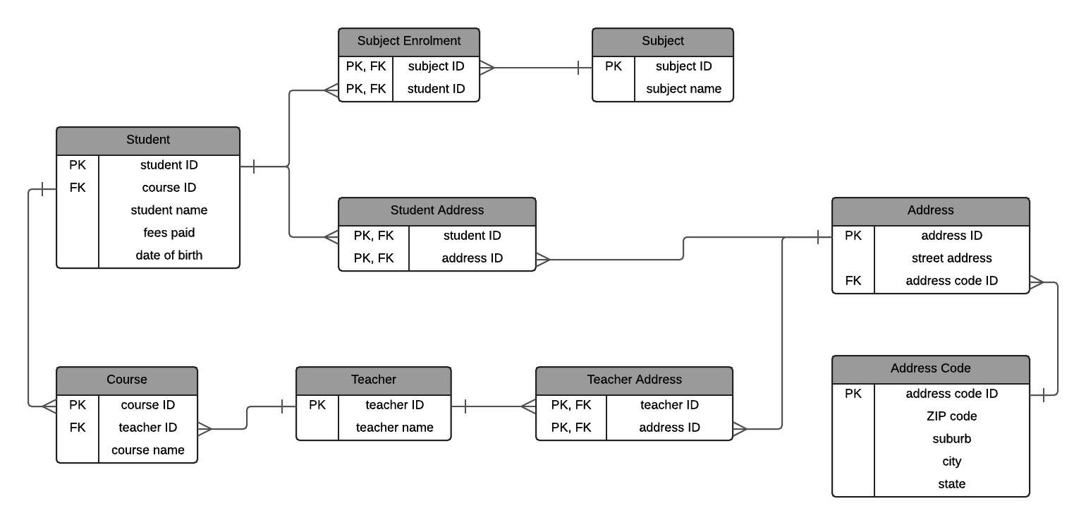
3NF Diagram - Bing images

Slide 36
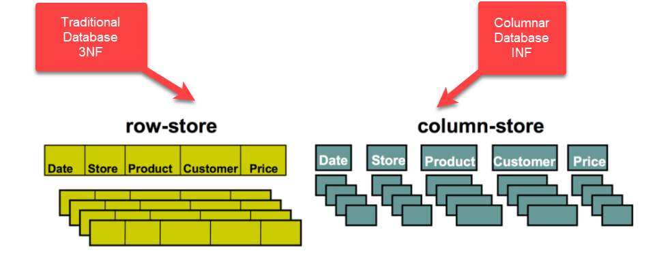

Slide 37
Vertipaq Engine
Import mode
Columnar Structure – encodes and compresses data within each column
Works out the position of each row within the column
Establishes relationships
Computes and compresses calculated tables and columns
Notes:
VertiPaq – “Brain & Muscles” behind Power BI - Data Mozart (data-mozart.com)
Different from a normal database which is row store – requirements are different

Slide 38
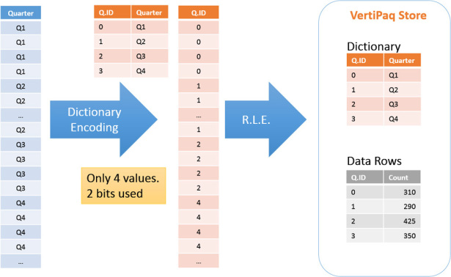
image: microsoftpressstore.com, Ferrari, Russo

Slide 39
Why?
Quick – Filter, Group, Create Expression
Optimal steps to achieve compression and better performance
Have a star schema
Only bring in what you need
Transformations up stream
Be efficient with your datatypes and your columns.
Optimise your DAX
Apply filters on columns not tables.
Stop when it is good enough.
Notes:
1. Have a star schema (stay away from bi-directional filtering unless you really understand what it does).
2. Only bring in what you need from the source and push your transformations as far up-stream as possible.
3. Be efficient with your datatypes and your columns.
4. Optimise your DAX by understanding how the storage engine and formula engine works.
5. Apply filters on columns not tables.
6. Stop when it is good enough.

Slide 40
Learning Outcomes
You will be able to:
Recognise the key basic concepts behind different types of data
Understand the importance of data types
Learn how to effectively model data within Power BI
Understand what is meant by normalised data
The importance of a Star Schema
How the engine works
Notes:
You will be able to:
Recognise the key basic concepts behind different types of data and how they’re used
Explain the life cycle of organisational data and how to manage it
Be aware of the different tools used for managing data and analysing data
Describe common obstacles and hurdles to effectively leverage data

